Slide 1
Android
Lab 04
2017-2018

Slide 2
Agenda
Menus
Options Menu
Sub Menu
Context Menu

Slide 3
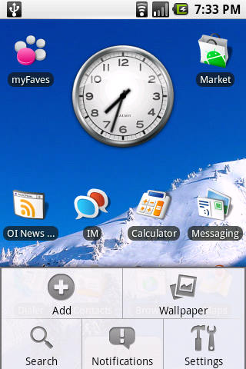


Options Menu
Press MENU key in an Activity.
Supports icons, but not checkboxes or radio buttons.
Notes:
Tag for icon: android:icon="@drawable/ic_launcher“
Shortcut: android:alphabeticShortcut="y“
android:numericShortcut="1“
The Expanded Menu The expanded menu is triggered when a user selects the More Menu Item from the icon menu.
displays a scrollable list of only the Menu Items that weren’t visible in the icon menu. This menu displays full text, shortcut keys, and checkboxes/radio buttons as appropriate.It doesn’t display icons.
Pressing the Back button closes the expanded menu and navigate back to the option menu
If you've developed your application for Android 2.3.x (API level 10) or lower, the contents of your options menu appear at the bottom of the screen when the user presses the Menu button When opened, the first visible portion is the icon menu, which holds up to six menu items. If your menu includes more than six items, Android places the sixth item and the rest into the overflow menu, which the user can open by selecting More.

Slide 4
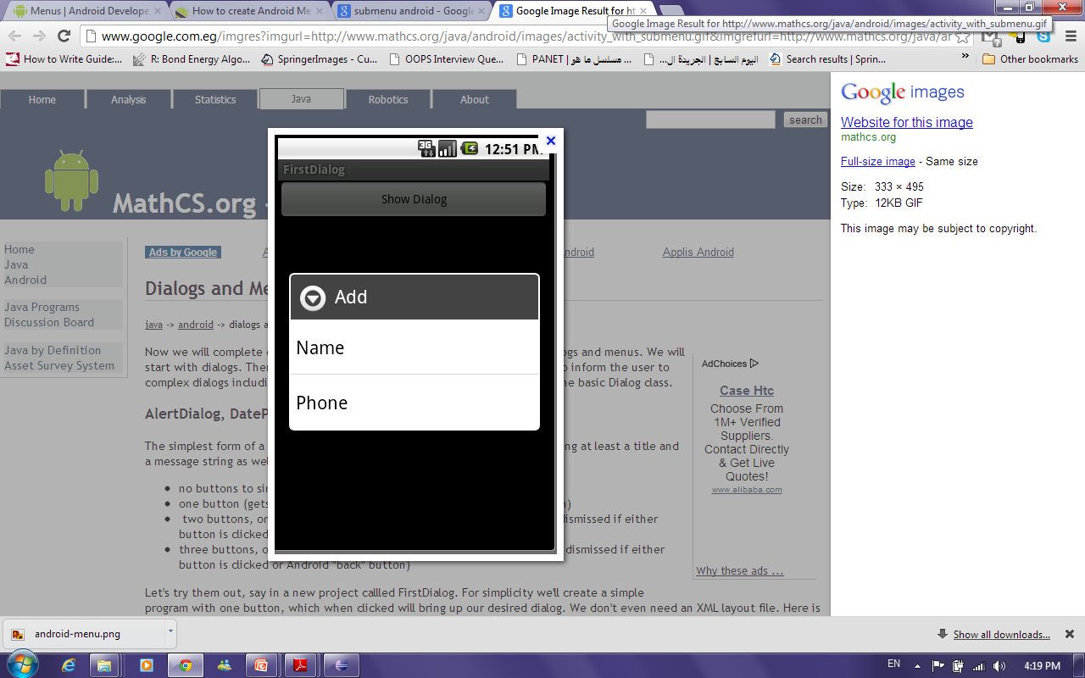
Sub Menu
Menu for a menu item.
Sub menus do not support nested sub menus.

Slide 5
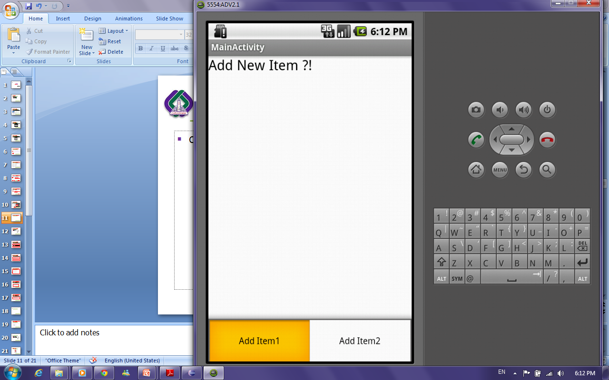
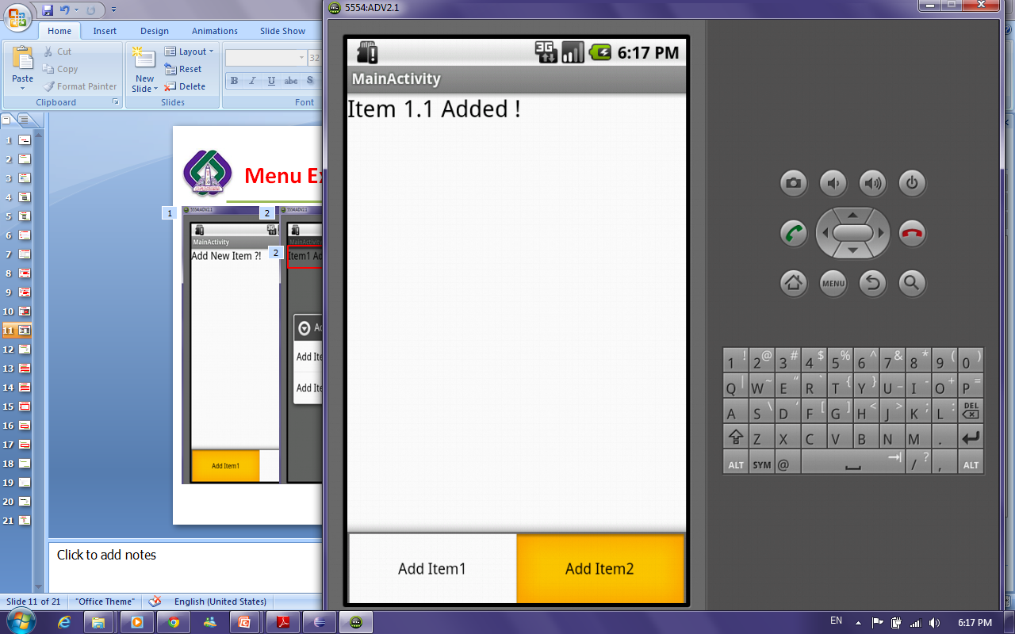
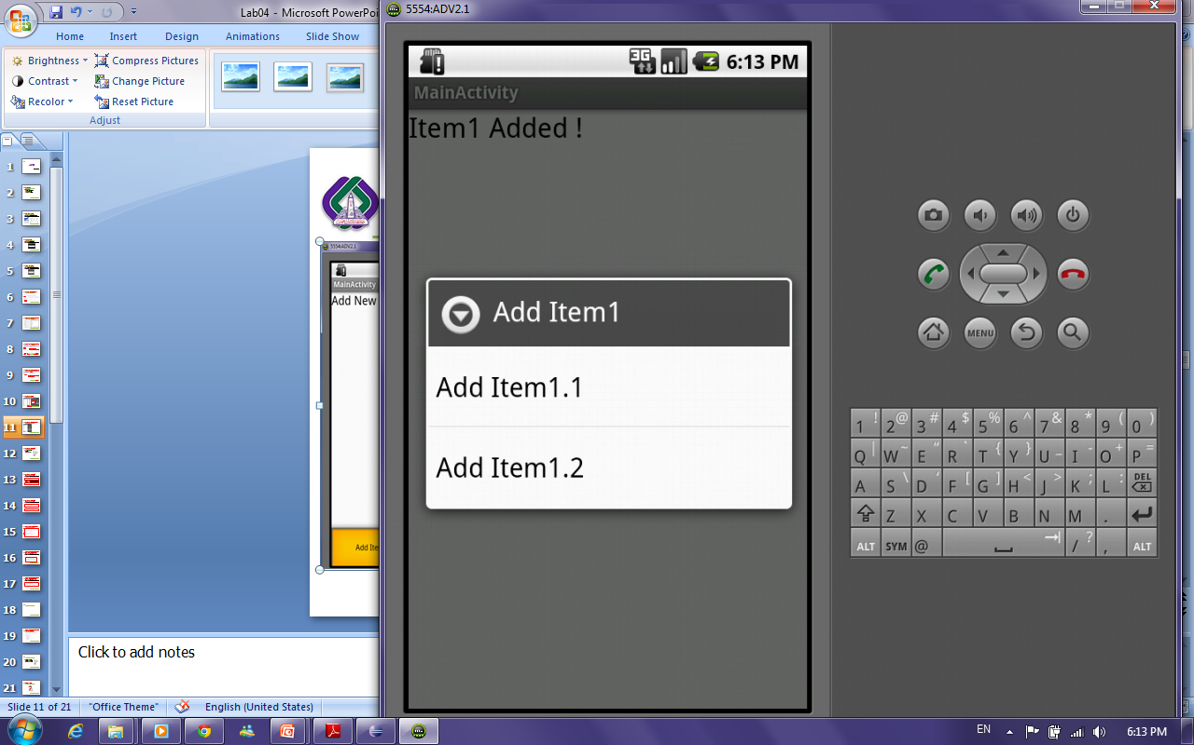
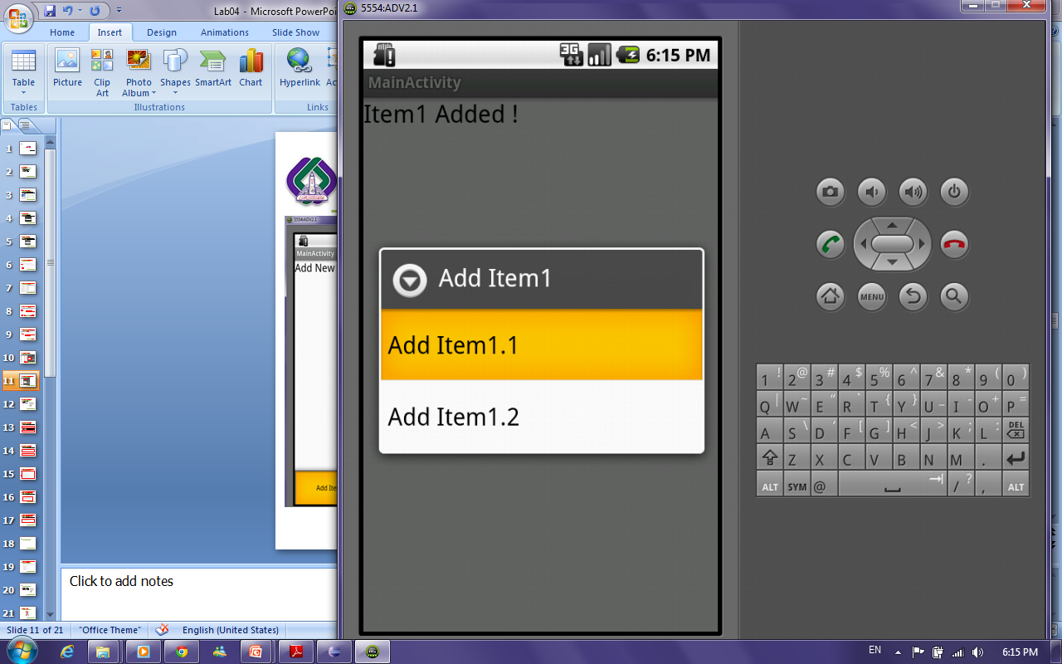
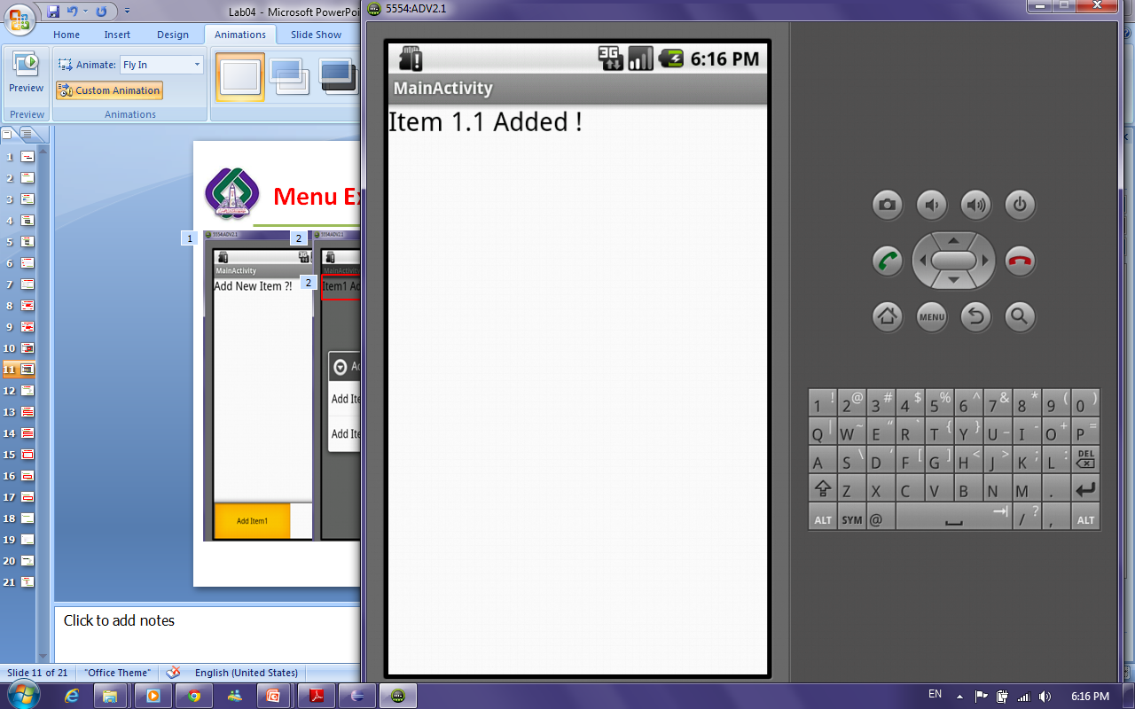
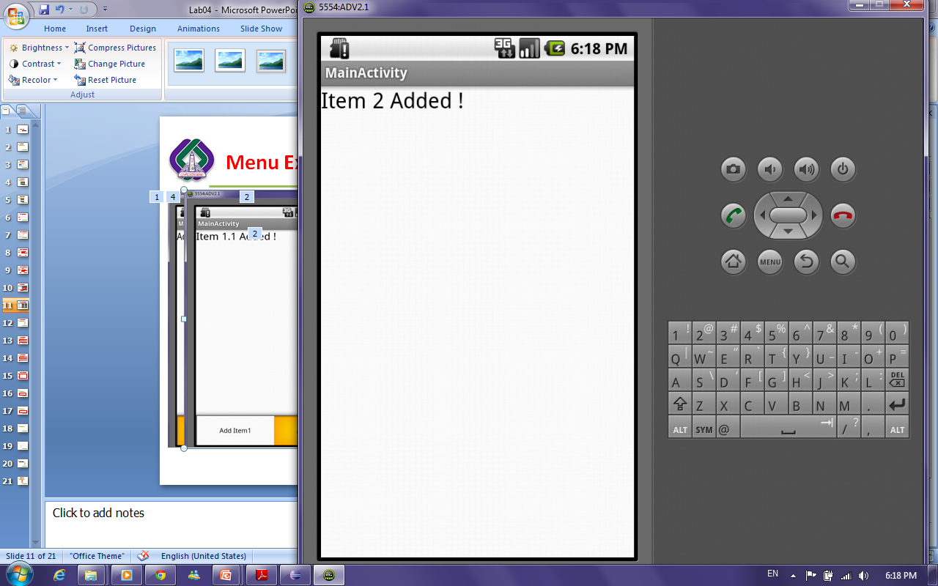
Options and Sub Menu Example

Slide 6
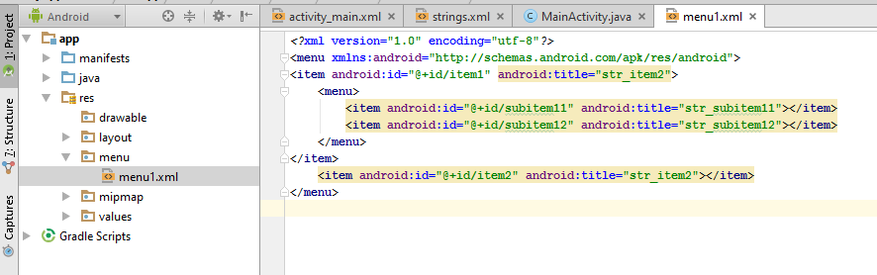
Where the menus exist !!
Notes:
@id and @+id
http://stackoverflow.com/questions/11160954/what-is-the-difference-between-id-and-id

Slide 7
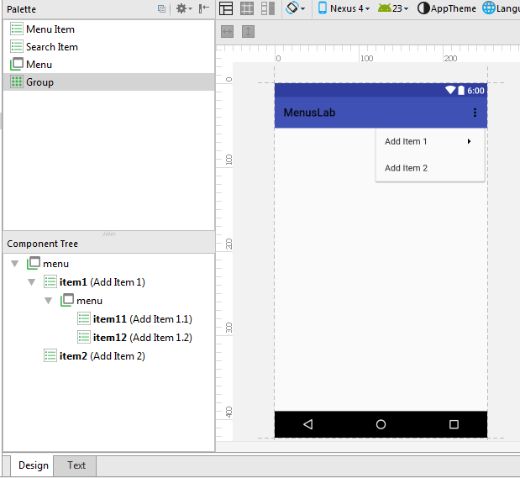
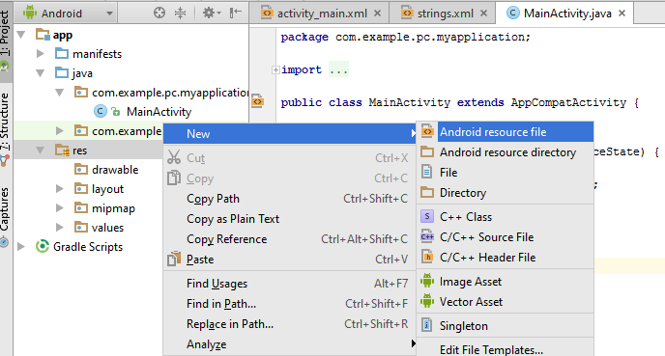
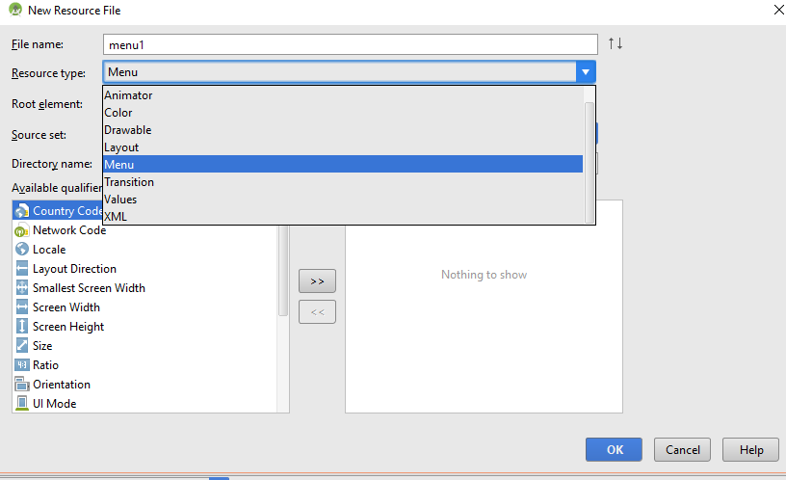
How to add menu file !!
Notes:
Menu Resource Attributes:
http://developer.android.com/guide/topics/resources/menu-resource.html
ocClick: takes the method name to execute
If room: If there's not enough room for the item in the action bar, it will appear in the action overflow.
With text:If your menu item supplies both a title and an icon—with the title and icon attributes—then the action item shows only the icon by default. If you want to display the text title, add "withText" to the showAsActionattribute.
Action view: An action view is a widget that appears in the action bar as a substitute for an action button. An action view provides fast access to rich actions without changing activities or fragments, and without replacing the action bar. For example, if you have an action for Search, you can add an action view to embeds a SearchView widget in the action bar
Action provider: Similar to an action view, an action provider replaces an action button with a customized layout. However, unlike an action view, an action provider takes control of all the action's behaviors and an action provider can display a submenu when pressed.
Because each ActionProvider class defines its own action behaviors, you don't need to listen for the action in theonOptionsItemSelected() method.
To declare an action view, use either the actionLayout or actionViewClass attribute to specify either a layout resource or widget class to use, respectively.
http://developer.android.com/guide/topics/ui/actionbar.html

Slide 8
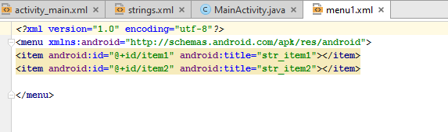
How to add options menu items:

Slide 9
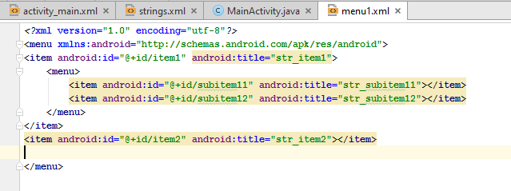
How to add submenu for a menu item !!

Slide 10
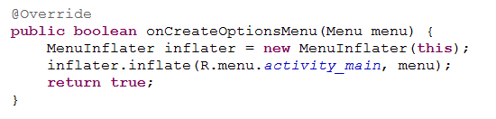
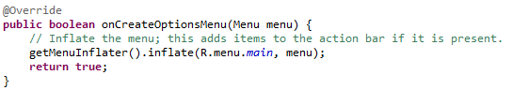
How to bind menu defined in xml file to the options menu to be shown
On the “onCreateOptionsMenu” method create object from “MenuInflater” Class and then call inflate method.
Notes:
MenuInflater: This class is used to instantiate menu XML files into Menu objects.
We can use:
MenuInflater inflater = getMenuInflater();
Instead of
MenuInflater inflater = new MenuInflater(this);

Slide 11
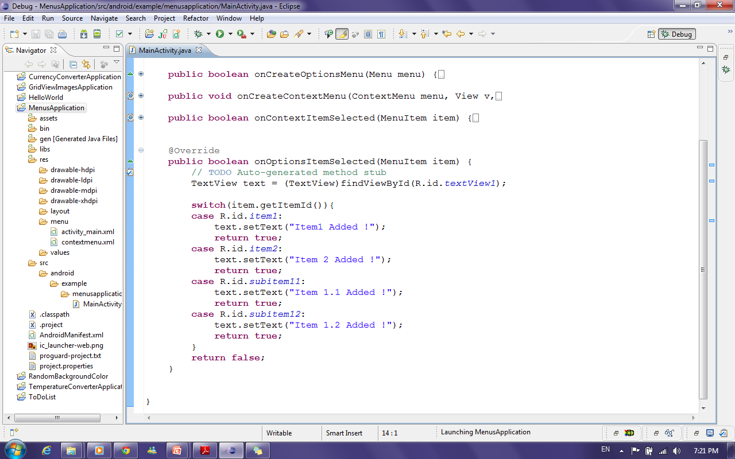
How to update TextView text when selecting any menu item from options and Sub menu?!
To handle event of selecting a certain options menu item use the “onOptionsItemSelected “ method
Get TextView
Check which item is
selected from options Menu and update TextView Text

Slide 12
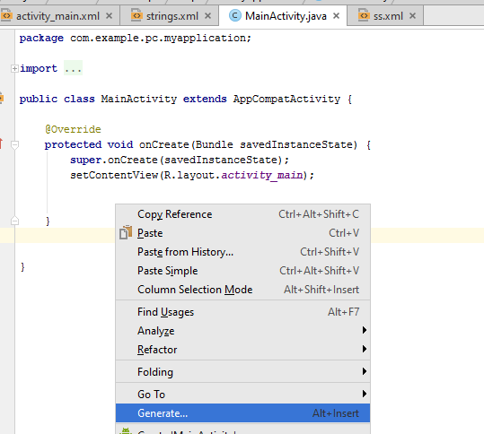
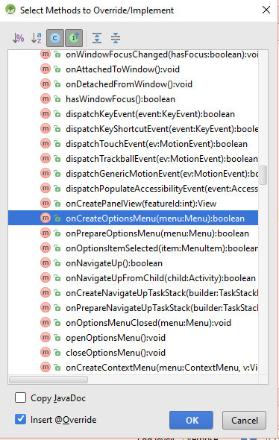
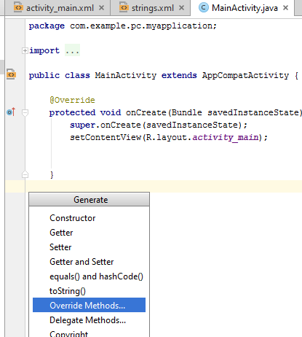
How to override Methods ?!

Slide 13

Options and Sub Menu Example Cont’
30 Minutes
Design Menus
Add Functionality

Slide 14
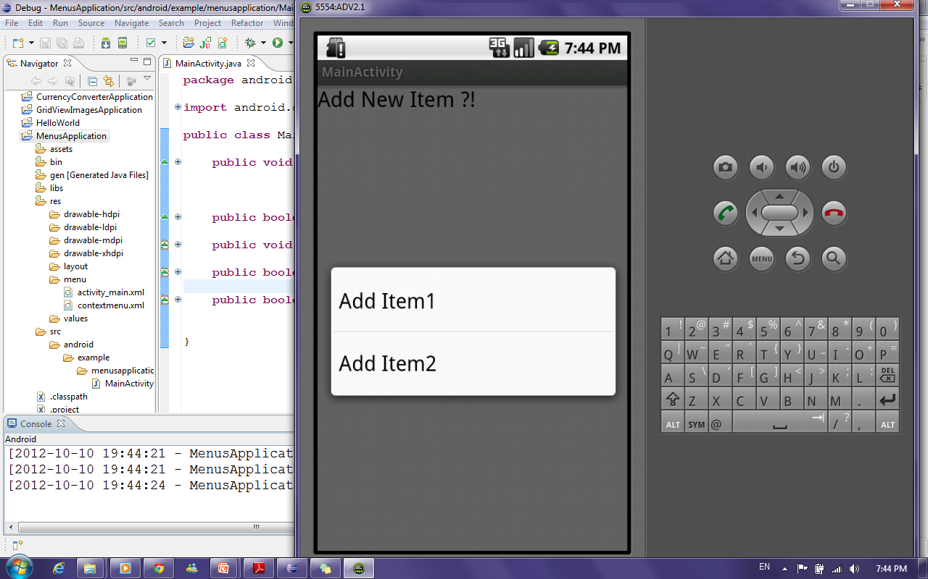
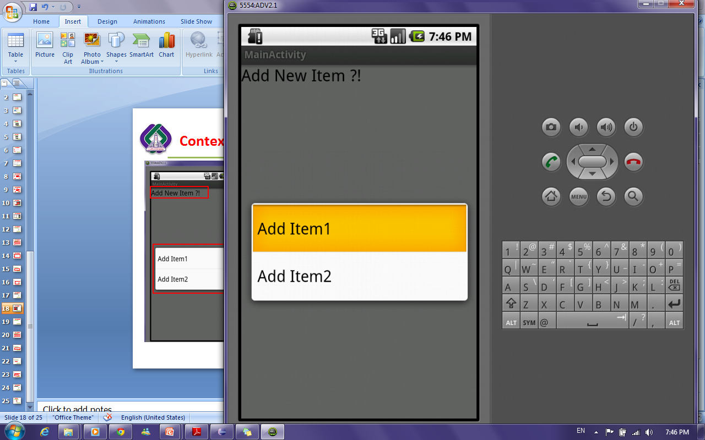
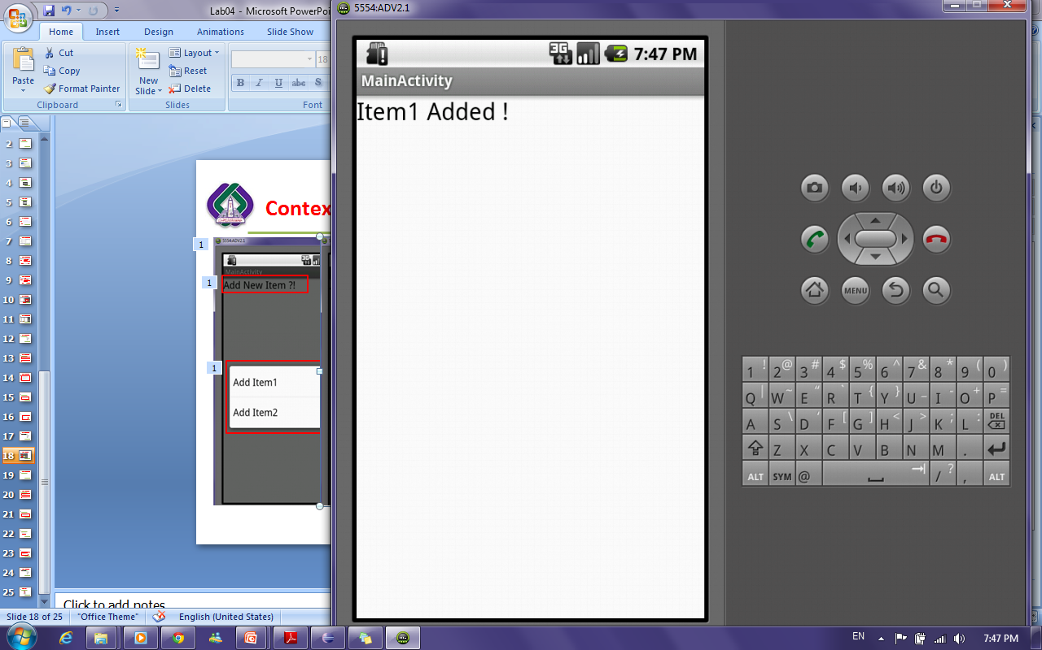
Context Menu Example

Slide 15
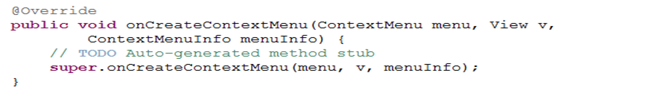
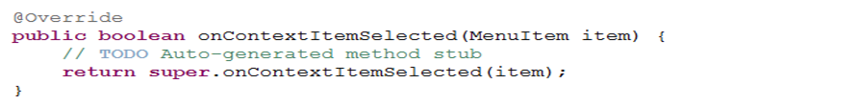
Context Menu Example Cont’
To Show context menu when long-pressing TextView, Override the “onCreateContextMenu” method
To handle event of selecting a certain context menu item, Override the “onContextItemSelected” method

Slide 16
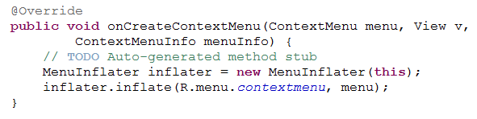
How to bind menu defined in xml file to the context menu to be shown
On the “onCreateContextMenu” method create object from “MenuInflater” Class and then call inflate method.

Slide 17
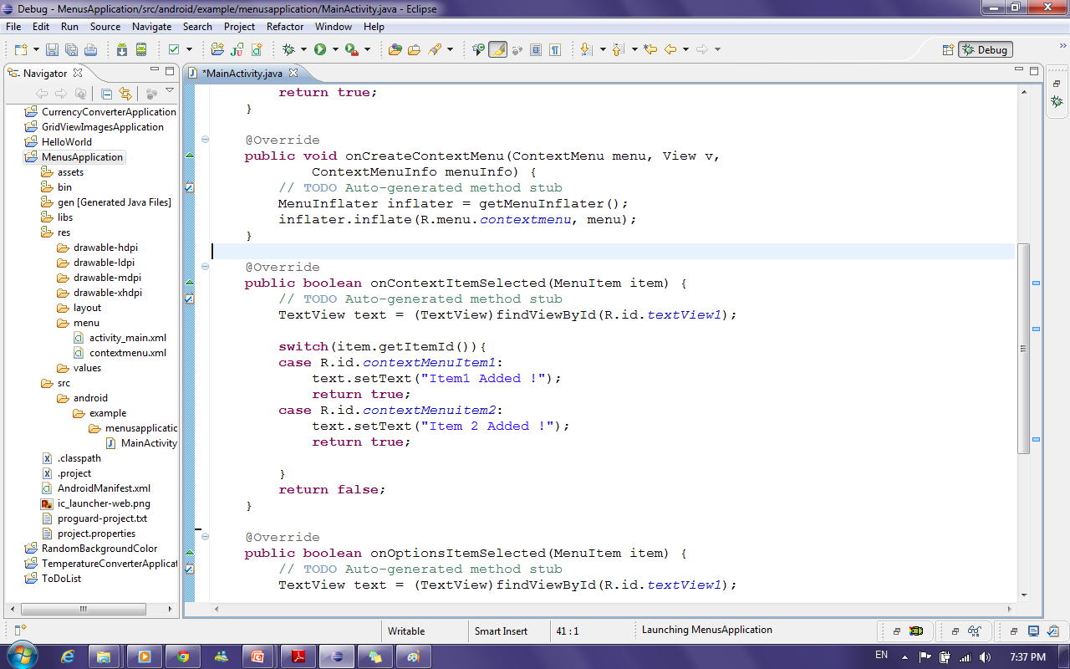
How to update TextView text when selecting any menu item from Context menu?!
Get TextView
Check which item is
selected from context Menu and update TextView Text

Slide 18
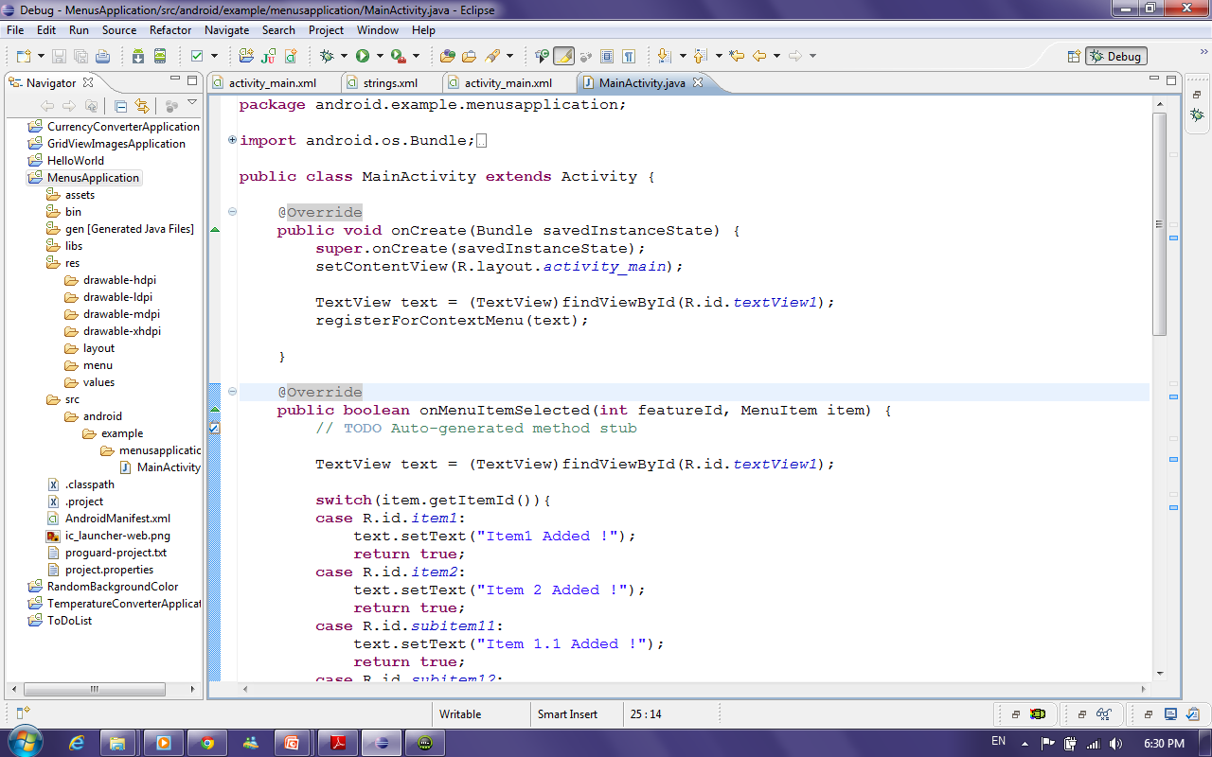
How to bind context menu with TextView ?!
In the OnCreate Method of the activity
Get TextView
Bind Context Menu to TextView

Slide 19
Context Menu Example Cont’
20 Minutes
Generate new menu file
Add Functionality

